Slide 1
Data Mining:
Concepts and Techniques
(3rd ed.)
— Chapter 6 —
Jiawei Han, Micheline Kamber, and Jian Pei
University of Illinois at Urbana-Champaign &
Simon Fraser University
©2011 Han, Kamber & Pei. All rights reserved.

Slide 2
Chapter 5: Mining Frequent Patterns, Association and Correlations: Basic Concepts and Methods
Basic Concepts
Frequent Itemset Mining Methods
Which Patterns Are Interesting?—Pattern Evaluation Methods
Summary

Slide 3
What Is Frequent Pattern Analysis?
Frequent pattern: a pattern (a set of items, subsequences, substructures, etc.) that occurs frequently in a data set
First proposed by Agrawal, Imielinski, and Swami [AIS93] in the context of frequent itemsets and association rule mining
Motivation: Finding inherent regularities in data
  What products were often purchased together?— Beer and diapers?!
  What are the subsequent purchases after buying a PC?
  What kinds of DNA are sensitive to this new drug?
  Can we automatically classify web documents?
Applications
  Basket data analysis, cross-marketing, catalog design, sale campaign analysis, Web log (click stream) analysis, and DNA sequence analysis.

Slide 4
Why Is Freq. Pattern Mining Important?
Freq. pattern: An intrinsic and important property of datasets
Foundation for many essential data mining tasks
  Association, correlation, and causality analysis
  Sequential, structural (e.g., sub-graph) patterns
  Pattern analysis in spatiotemporal, multimedia, time-series, and stream data
  Classification: discriminative, frequent pattern analysis
  Cluster analysis: frequent pattern-based clustering
  Data warehousing: iceberg cube and cube-gradient
  Semantic data compression: fascicles
  Broad applications

Slide 5
Basic Concepts: Frequent Patterns
Tid | Items bought
10 | Beer, Nuts, Diaper
20 | Beer, Coffee, Diaper
30 | Beer, Diaper, Eggs
40 | Nuts, Eggs, Milk
50 | Nuts, Coffee, Diaper, Eggs, Milk
itemset: A set of one or more items
k-itemset X = {x₁, …, x_{k}}
(absolute) support, or, support count of X: Frequency or occurrence of an itemset X
(relative) support, s, is the fraction of transactions that contains X (i.e., the probability that a transaction contains X)
An itemset X is frequent if X’s support is no less than a minsup threshold
Customer
buys both
Customer
buys diaper
Customer
buys beer

Slide 6
Basic Concepts: Association Rules
Tid
Items bought
Find all the rules X → Y with minimum support and confidence
  support, s, probability that a transaction contains X ∪ Y
  confidence, c, conditional probability that a transaction having X also contains Y
Let minsup = 50%, minconf = 50%
Freq. Pat.: Beer:3, Nuts:3, Diaper:4, Eggs:3, {Beer, Diaper}:3
10
Beer, Nuts, Diaper
20
Beer, Coffee, Diaper
30
Beer, Diaper, Eggs
40
Nuts, Eggs, Milk
50
Nuts, Coffee, Diaper, Eggs, Milk
Customer
buys both
Customer
buys diaper
Customer
buys beer
Association rules: (many more!)
  Beer → Diaper (60%, 100%)
  Diaper → Beer (60%, 75%)

Slide 7
Closed Patterns and Max-Patterns
A long pattern contains a combinatorial number of sub-patterns, e.g., {a₁, …, a₁₀₀} contains (₁₀₀¹) + (₁₀₀²) + … + (₁¹₀⁰₀⁰) = 2¹⁰⁰ – 1 = 1.27*10³⁰ sub-patterns!
Solution: Mine closed patterns and max-patterns instead
An itemset X is closed if X is frequent and there exists no super-pattern Y כ X, with the same support as X (proposed by Pasquier, et al. @ ICDT’99)
An itemset X is a max-pattern if X is frequent and there exists no frequent super-pattern Y כ X (proposed by Bayardo @ SIGMOD’98)
Closed pattern is a lossless compression of freq. patterns
  Reducing the # of patterns and rules

Slide 8
Closed Patterns and Max-Patterns
Exercise. DB = {<a₁, …, a₁₀₀>, < a₁, …, a₅₀>}
  Min_sup = 1.
What is the set of closed itemset?
  <a₁, …, a₁₀₀>: 1
  < a₁, …, a₅₀>: 2
What is the set of max-pattern?
  <a₁, …, a₁₀₀>: 1
What is the set of all patterns?
  !!

Slide 9
Computational Complexity of Frequent Itemset Mining
How many itemsets are potentially to be generated in the worst case?
  The number of frequent itemsets to be generated is senstive to the minsup threshold
  When minsup is low, there exist potentially an exponential number of frequent itemsets
  The worst case: M^{N} where M: # distinct items, and N: max length of transactions
The worst case complexty vs. the expected probability
  Ex. Suppose Walmart has 10⁴ kinds of products
    The chance to pick up one product 10⁻⁴
    The chance to pick up a particular set of 10 products: ~10⁻⁴⁰
    What is the chance this particular set of 10 products to be frequent 10³ times in 10⁹ transactions?

Slide 10
Chapter 5: Mining Frequent Patterns, Association and Correlations: Basic Concepts and Methods
Basic Concepts
Frequent Itemset Mining Methods
Which Patterns Are Interesting?—Pattern Evaluation Methods
Summary

Slide 11
Scalable Frequent Itemset Mining Methods
Apriori: A Candidate Generation-and-Test Approach
Improving the Efficiency of Apriori
FPGrowth: A Frequent Pattern-Growth Approach
ECLAT: Frequent Pattern Mining with Vertical Data Format

Slide 12
The Downward Closure Property and Scalable Mining Methods
The downward closure property of frequent patterns
  Any subset of a frequent itemset must be frequent
  If {beer, diaper, nuts} is frequent, so is {beer, diaper}
  i.e., every transaction having {beer, diaper, nuts} also contains {beer, diaper}
Scalable mining methods: Three major approaches
  Apriori (Agrawal & Srikant@VLDB’94)
  Freq. pattern growth (FPgrowth—Han, Pei & Yin @SIGMOD’00)
  Vertical data format approach (Charm—Zaki & Hsiao @SDM’02)

Slide 13
Apriori: A Candidate Generation & Test Approach
Apriori pruning principle: If there is any itemset which is infrequent, its superset should not be generated/tested! (Agrawal & Srikant @VLDB’94, Mannila, et al. @ KDD’ 94)
Method:
  Initially, scan DB once to get frequent 1-itemset
  Generate length (k+1) candidate itemsets from length k frequent itemsets
  Test the candidates against DB
  Terminate when no frequent or candidate set can be generated

Slide 14
The Apriori Algorithm—An Example
Sup_{min} = 2
Itemset | sup
{A} | 2
{B} | 3
{C} | 3
{D} | 1
{E} | 3
Database TDB
Itemset | sup
{A} | 2
{B} | 3
{C} | 3
{E} | 3
L₁
Tid | Items
10 | A, C, D
20 | B, C, E
30 | A, B, C, E
40 | B, E
C₁
1st scan
C₂
Itemset | sup
{A, B} | 1
{A, C} | 2
{A, E} | 1
{B, C} | 2
{B, E} | 3
{C, E} | 2
C₂
L₂
Itemset
{A, B}
{A, C}
{A, E}
{B, C}
{B, E}
{C, E}
Itemset | sup
{A, C} | 2
{B, C} | 2
{B, E} | 3
{C, E} | 2
2nd scan
C₃
Itemset
{B, C, E}
3rd scan
L₃
Itemset | sup
{B, C, E} | 2

Slide 15
Steps of Apriori algorithm
C1 → σ(C1) → filter → L1 →Prune(join(L1* L1) →
C2 → σ(C2) → filter → L2 →Prune(join(L2* L2) →
C3→ σ(C3) → filter → L3 →Prune(join(L3* L3) →
So on till C_{K+1} is a null set

Slide 16
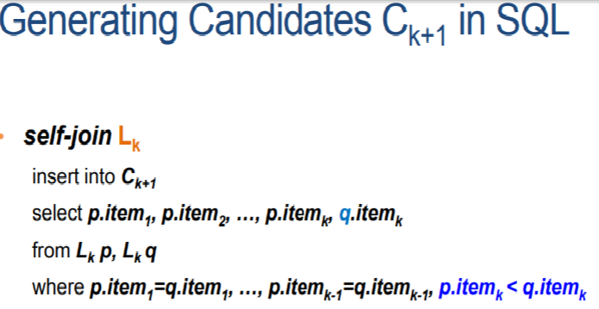


Step: Candidate Pruning
How to generate candidates? (Computing Prune(join(L_{k}, L_{k}))
  Step 1: self-joining L_{k}
  Step 2: pruning

Slide 17
Prune(join(L1 *L1))
L1={ {A}, {B}, {C}, {E} }
L1 * L1
Join (L1 * L1) = { {A,B}, {A,C}, {A,E}, {B,C}, {B,E}, {C,E}}
No Pruning required for any itemset as all subsets are frequent
{A}
{B}
{C}
{E}
{A}
{B}
{C}
{E}

Slide 18
Prune(Join(L2 * L2))
L2= { {A,B}, {A,C}, {A,E}, {B,C}, {B,E}, {C,E}}
Join(L2 * L2)
    Join({A,B}, {A,C}) ={A,B,C}
    Join({A,B}, {A,E}) = {A, B,E}
    Join({A,B}, {B,C}) ={A,B,C} and so on
  Similarly you get Join(L2 * L2) ={{A,B,C}, {A, B,E}, {A,B,C,E}, {A,C,E}, {B,C,E}}
Prune(Join(L2*L2)) = {B,C,E}
  As all the others have an infrequent subset.

Slide 19
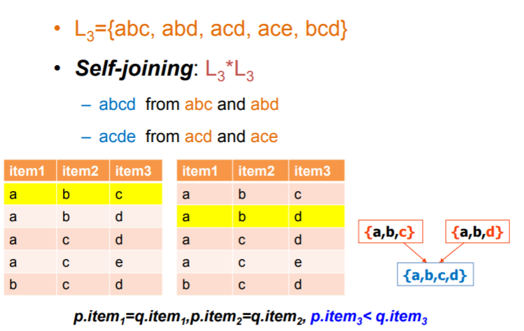
Step: Candidate Generation
Example-1 of self Joining

Slide 20
Rule Generation for the previous Example
Database TDB
L₁
L₂
L₃
Tid | Items
10 | A, C, D
20 | B, C, E
30 | A, B, C, E
40 | B, E
Itemset | sup
{A} | 2
{B} | 3
{C} | 3
{E} | 3
Itemset | sup
{A, C} | 2
{B, C} | 2
{B, E} | 3
{C, E} | 2
Itemset | sup
{B, C, E} | 2
Consider the frequent item set {B,C,E} and min confidence= 70%, the association rules are as follows:
    {C, E} → {B} Confidence = 2/2 =100% Rule accepted
    {B, E} →{C} Confidence = 2/3 =67 % Rule Rejected
    {B,C} →{E} Confidence = 2/2 =100 % Rule accepted
    {B} → {C, E} pruned
    {C} → {B, E} Confidence = 2/3 =67 % Rule Rejected
    {E} → {B,C} pruned

Slide 21
The Apriori Algorithm (Pseudo-Code)
C_{k}: Candidate itemset of size k
L_{k} : frequent itemset of size k
L₁ = {frequent items};
for (k = 1; L_{k} !=∅; k++) do begin
C_{k+1} = candidates generated from L_{k};
for each transaction t in database do
  increment the count of all candidates in C_{k+1} that are contained in t
L_{k+1} = candidates in C_{k+1} with min_support
end
return ∪_{k} L_{k};

Slide 22
Implementation of Apriori
How to generate candidates?
  Step 1: self-joining L_{k}
  Step 2: pruning
Example of Candidate-generation
  L₃={abc, abd, acd, ace, bcd}
  Self-joining: L₃*L₃
    abcd from abc and abd
    acde from acd and ace
  Pruning:
    acde is removed because ade is not in L₃
  C₄ = {abcd}

Slide 23
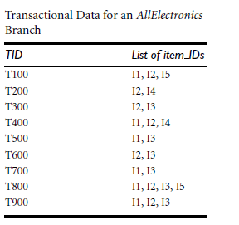
Min_sup = 2

Slide 24
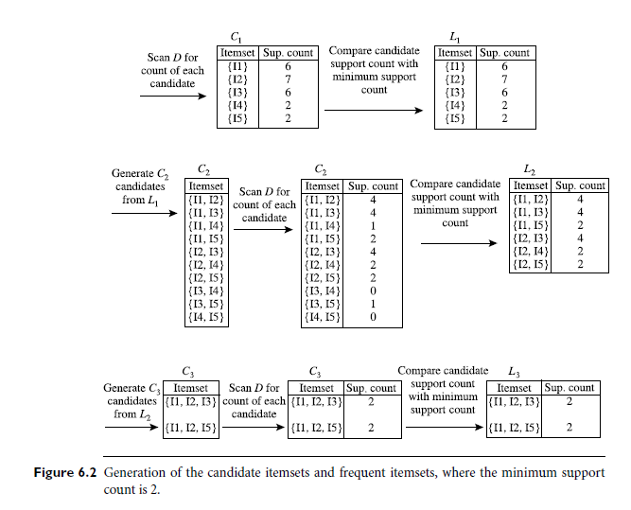

Slide 25
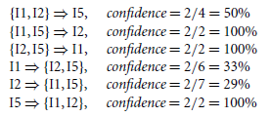
Generating association rules
frequent itemset X ={I1, I2,I5}.What are the association rules that can be generated from X?
The nonempty subsets of X are {I1, I2}, {I1, I5}, {I2, I5}, {I1}, {I2}, and {I5}. The resulting association rules are as shown below, each listed with its confidence:
If the minimum confidence threshold is, say, 70%, then only the second, third, and last rules are output, because these are the only ones generated that are strong.

Slide 26
Candidate Generation: An SQL Implementation
SQL Implementation of candidate generation
  Suppose the items in L_{k-1} are listed in an order
  Step 1: self-joining L_{k-1}
    insert into C_{k}
    select p.item₁, p.item₂, …, p.item_{k-1}, q.item_{k-1}
    from L_{k-1} p, L_{k-1} q
    where p.item₁=q.item₁, …, p.item_{k-2}=q.item_{k-2}, p.item_{k-1} < q.item_{k-1}
  Step 2: pruning
    forall itemsets c in C_{k} do
      forall (k-1)-subsets s of c do
        if (s is not in L_{k-1}) then delete c from C_{k}
Use object-relational extensions like UDFs, BLOBs, and Table functions for efficient implementation [See: S. Sarawagi, S. Thomas, and R. Agrawal. Integrating association rule mining with relational database systems: Alternatives and implications. SIGMOD’98]

Slide 27
Scalable Frequent Itemset Mining Methods
Apriori: A Candidate Generation-and-Test Approach
Improving the Efficiency of Apriori
FPGrowth: A Frequent Pattern-Growth Approach
ECLAT: Frequent Pattern Mining with Vertical Data Format
Mining Close Frequent Patterns and Maxpatterns

Slide 28
Further Improvement of the Apriori Method
Major computational challenges
  Multiple scans of transaction database
  Huge number of candidates
  Tedious workload of support counting for candidates
Improving Apriori: general ideas
  Reduce passes of transaction database scans
  Shrink number of candidates
  Facilitate support counting of candidates

Slide 29
Partition: Scan Database Only Twice
Any itemset that is potentially frequent in DB must be frequent in at least one of the partitions of DB
  Scan 1: partition database and find local frequent patterns
  Scan 2: consolidate global frequent patterns
A. Savasere, E. Omiecinski and S. Navathe, VLDB’95
DB₁
+
DB₂
+
+
DB_{k}
= DB
sup₁(i) < σDB₁
sup₂(i) < σDB₂
sup_{k}(i) < σDB_{k}
sup(i) < σDB

Slide 30
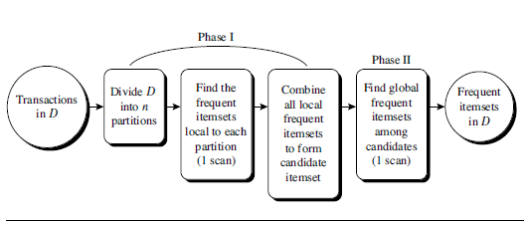


Slide 31
Sampling for Frequent Patterns
Select a sample of original database, mine frequent patterns within sample using Apriori
Scan database once to verify frequent itemsets found in sample, only borders of closure of frequent patterns are checked
  Example: check abcd instead of ab, ac, …, etc.
Scan database again to find missed frequent patterns
H. Toivonen. Sampling large databases for association rules. In VLDB’96

Slide 32
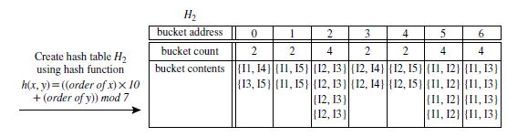
Hash-based technique
Hash table, H2, for candidate 2-itemsets. This hash table was generated by scanning Table 6.1’s transactions while determining L1. If the minimum support count is, say, 3, then the itemsets in buckets 0, 1, 3, and 4 cannot be frequent and so they should not be included in C2.

Slide 33
A hash-based technique can be used to reduce the size of the candidate k-itemsets, Ck, for k > 1.
For example, when scanning each transaction in the database to generate the frequent 1-itemsets, L1, we can generate all the 2-itemsets for each transaction, hash (i.e., map) them into the different buckets of a hash table structure, and increase the corresponding bucket counts (Figure 6.5).
A 2-itemset with a corresponding bucket count in the hash table that is below the support threshold cannot be frequent and thus should be removed from the candidate set. Such a hash-based technique may substantially reduce the number of candidate k-itemsets examined (especially when k = 2).

Slide 34
Transaction reduction (reducing the number of transactions scanned in future iterations):
A transaction that does not contain any frequent k-itemsets cannot contain any frequent (k +1)-itemsets. Therefore, such a transaction can be marked or removed from further consideration because subsequent database scans for j- itemsets, where j > k, will not need to consider such a transaction.

